Slide 1
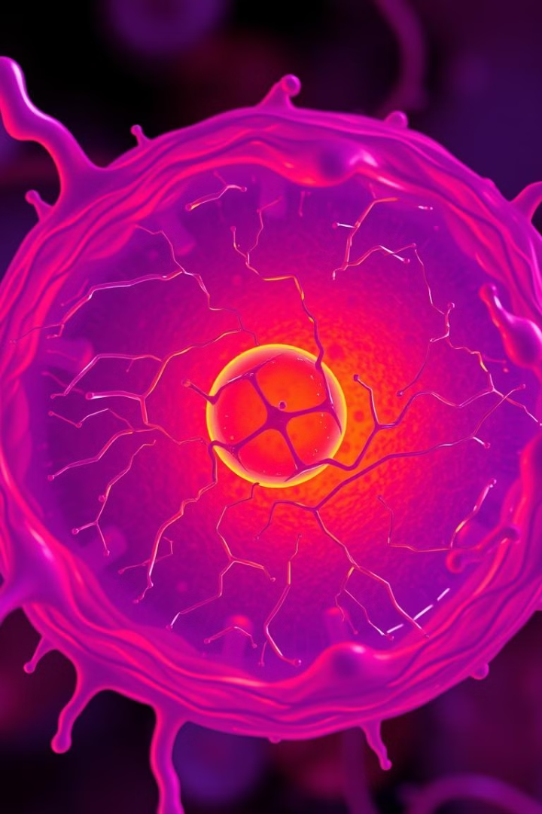
Lysosomes: The Cellular Recycling Centers
Lysosomes are tiny organelles within cells that play a vital role in cellular health, recycling waste and breaking down cellular components.

Slide 2
What are Lysosomes?
Cellular Compartments
Recycling Centers
Lysosomes are membrane-bound organelles found in almost all animal cells.
They contain a variety of enzymes capable of breaking down cellular waste, worn-out organelles, and invading pathogens.

Slide 3

Structure and Composition of Lysosomes
Membrane-Bound
Enzymes
Lysosomes are surrounded by a single membrane that separates their acidic environment from the rest of the cell.
They contain about 60 different types of hydrolytic enzymes, each specializing in breaking down a specific type of molecule.

Slide 4
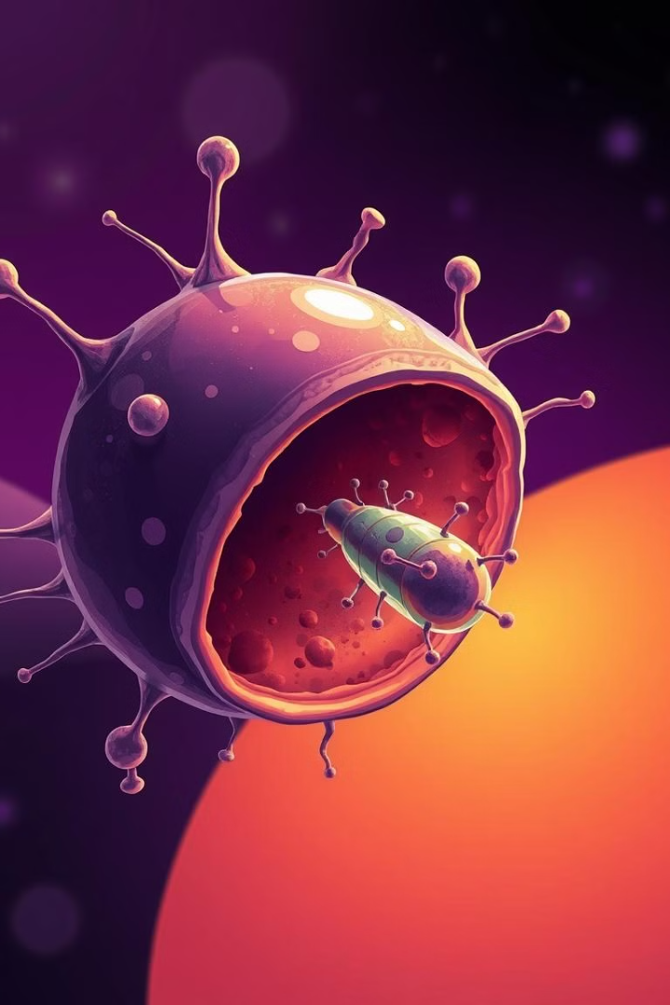



Functions of Lysosomes
Waste Removal
Defense
Lysosomes break down cellular debris, worn-out organelles, and other waste products.
Lysosomes destroy invading pathogens, such as bacteria and viruses, protecting the cell from infection.
Recycling
They break down cellular components into reusable building blocks, contributing to cellular renewal and growth.

Slide 5




Lysosomal Storage Disorders
1
Genetic Basis
Enzyme Deficiencies
2
These disorders arise from mutations in genes that code for lysosomal enzymes.
Undigested Waste
3
Without functional enzymes, waste accumulates within lysosomes, leading to cell damage and dysfunction.
Disease Symptoms
4
Symptoms vary widely, depending on the affected enzyme, and can include neurological problems, skeletal deformities, and organ failure.

Slide 6
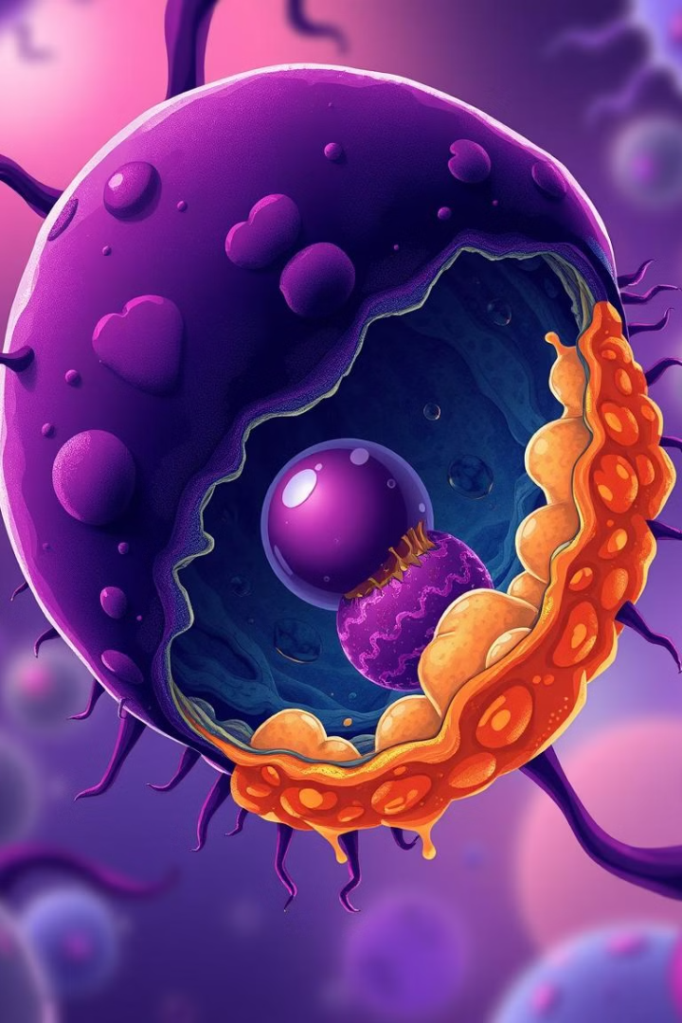
Autophagy and Lysosomes
1
Damaged organelles are tagged for destruction.
2
A double-membrane structure called an autophagosome encapsulates the target organelle.
3
The autophagosome fuses with a lysosome, delivering the organelle to the lysosome's acidic environment.
4
Lysosomal enzymes break down the organelle, recycling its components.

Slide 7
Lysosomes and Aging
Reduced Activity
1
Lysosomal activity declines with age, leading to reduced cellular recycling.
Waste Accumulation
2
Undigested waste products accumulate within lysosomes, contributing to cellular dysfunction.
Cellular Stress
3
The buildup of waste products stresses cells and accelerates the aging process.

Slide 8

Therapeutic Potential of Lysosomes
1
2
Enzyme Replacement
Drug Delivery
Replacing missing enzymes with engineered versions can treat certain lysosomal storage disorders.
Lysosomes can be used as drug delivery vehicles, targeting specific cells and tissues.
3
Anti-Aging Therapies
Boosting lysosomal function may hold promise for slowing down the aging process.

